Slide 1
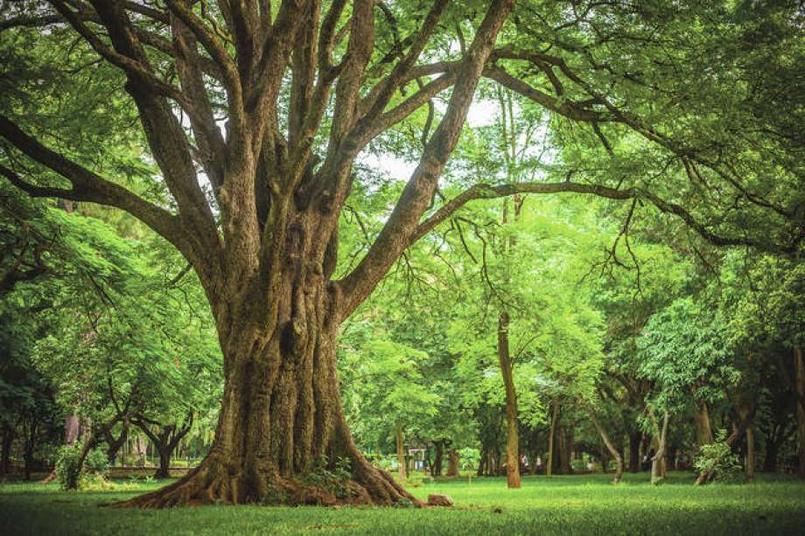
CSCI 1102 Computer Science 2
Meeting 1: Thursday 1/28/2021
Getting Started

Slide 2
CS2
CS1

Slide 3
Two Main Themes
Learning classic data structures & algorithms
Craftsmanship of software

Slide 4
Data Structures & Algorithms
Example: Data Compression

Slide 5
“ALABAMA”

Slide 6
“ALABAMA”
7 letters x 8-bits per letter => 56 bits

Slide 7
“ALABAMA”
‘A’ is run of the mill, ‘B’, ‘L’, & ‘M’
are more interesting, i.e., contain more
Information than ‘A’.

Slide 8
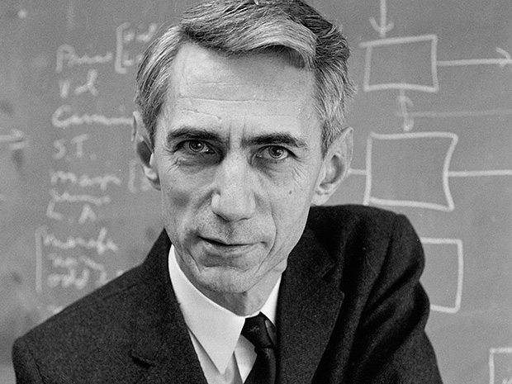

Slide 9
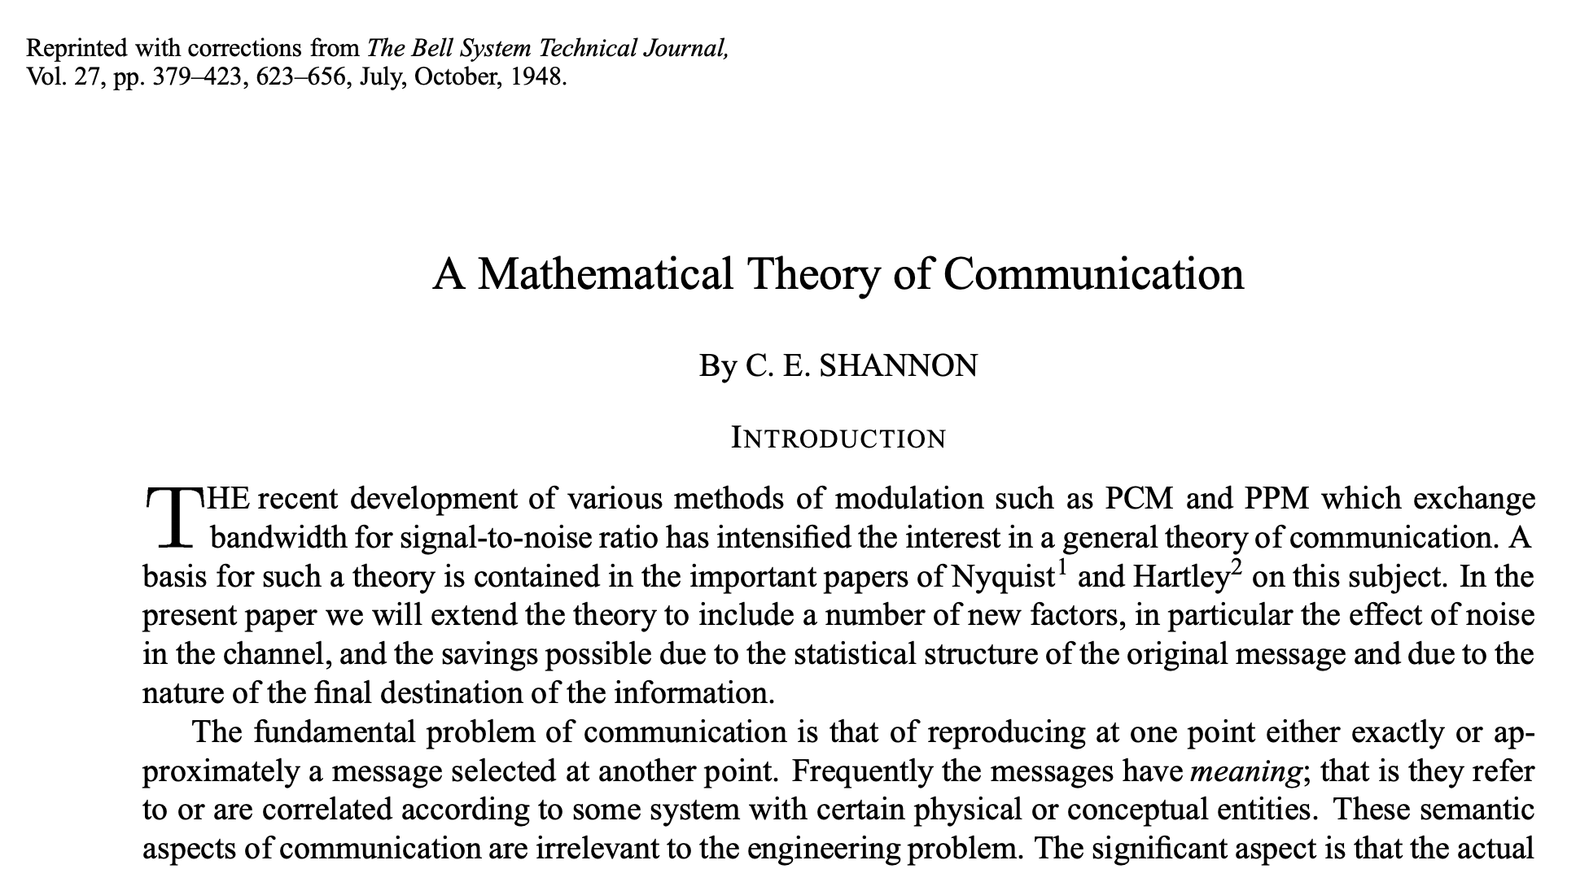

Slide 10
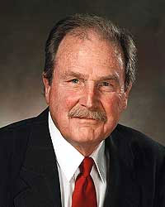

Slide 11
Instead of an 8-bit fixed-length code for a letter, choose a variable-length code reflecting the amount of information in the letter.

Slide 12
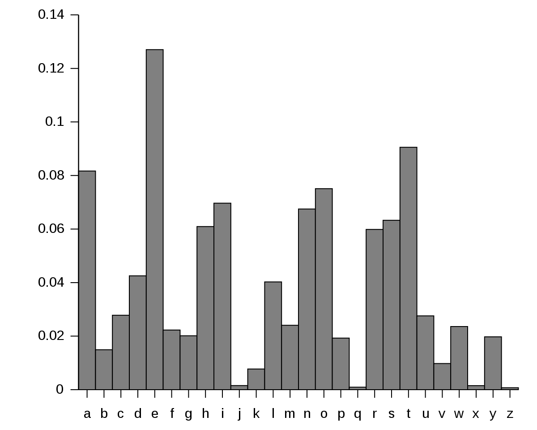

Slide 13
“ALABAMA”
A₄ L₁ B₁ M₁

Slide 14
“ALABAMA”
A₄ L₁ B₁ M₁
A Frequency Table

Slide 15

A Queue

Slide 16
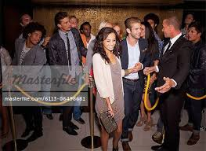
A Priority Queue

Slide 17
B₁ L₁ M₁ A₄
Low frequency
=> High Priority, head of the queue!
(letters arrived in
alphabetical order)
High frequency
Low Priority,
back of the queue!

Slide 18
B₁ L₁ M₁ A₄
Algorithm step: while the priority queue has more than one entry, remove two entries, combine them and reinsert the result back into the priority queue.

Slide 19
B₁ L₁ M₁ A₄

Slide 20
B₁ L₁
M₁ A₄

Slide 21
2
M₁ A₄
B₁ L₁
The items in the priority queue are weighted trees.

Slide 22
B₁ L₁ M₁ A₄
M₁ A₄
2
B₁ L₁
The items in the priority queue are weighted trees.

Slide 23
M₁ A₄
2
B₁ L₁
A₄
3
M₁
2
B₁ L₁

Slide 24
A₄
3
M₁
2
B₁ L₁

Slide 25
7
A₄
3
M₁
2
B₁ L₁

Slide 26
The Huffman Coding Tree
7
A₄
3
M₁
2
B₁ L₁

Slide 27
The Huffman Coding Tree
7
A₄
3
M₁
2
B₁ L₁
Left = 0
Right = 1

Slide 28
7
0
1
A₄
3
0
1
M₁
2
B₁ L₁
0
1

Slide 29
7
0
1
A₄
3
0
1
M₁
2
B₁ L₁
0
1
M = 00, B = 010; L = 011; A = 1

Slide 30
A L A B A M A
1 011 1 010 1 00 1
M = 00, B = 010; L = 011; A = 1

Slide 31
ALABAMA
101110101001
12 bits << 56 bits
M = 00, B = 010; L = 011; A = 1

Slide 32
2. Craftsmanship of software

Slide 33
How to write good code
Correct
Performant
Easy to read
Easy to write
Modular
Maintainable

Slide 34
Data Abstraction

Slide 35
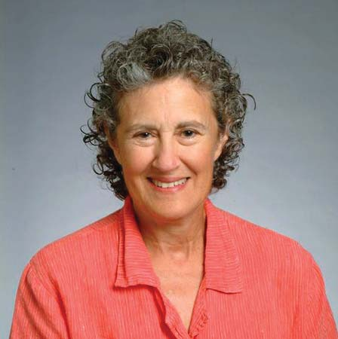

Slide 36
E.g., Frequency Table
Our programming language has types int, real, string, etc, but there is no frequency table type.
How to design and develop a new type?

Slide 37
Abstract Data Types
Decide what a client ought to be able to do with values of the new type, the operations.
Decide how to represent the new type so that the operations can be implemented efficiently.

Slide 38
Subplot
Trade-offs between block-allocation and linked allocation

Slide 39
Standard Data Structures & Algorithms
Stacks, Queues, Deques, Priority Queues, Binary Heaps, Binary Search Trees, Balanced Trees, Hash Tables, etc
Searching and Sorting

Slide 40
What this course is not about

Slide 41
This course uses the Java programming language as a tool, Java is not the subject of the course. This course is not about and does not cover object-oriented programming; in fact we don’t use it at all.

Slide 42
Pragmatics

Slide 43
Who are We?
Instructor: Robert Muller
TAs:
Callie Sardina, Head TA
Kristen Bayreuther
Emma Huang
Liam Murphy
We’re here to help.

Slide 44
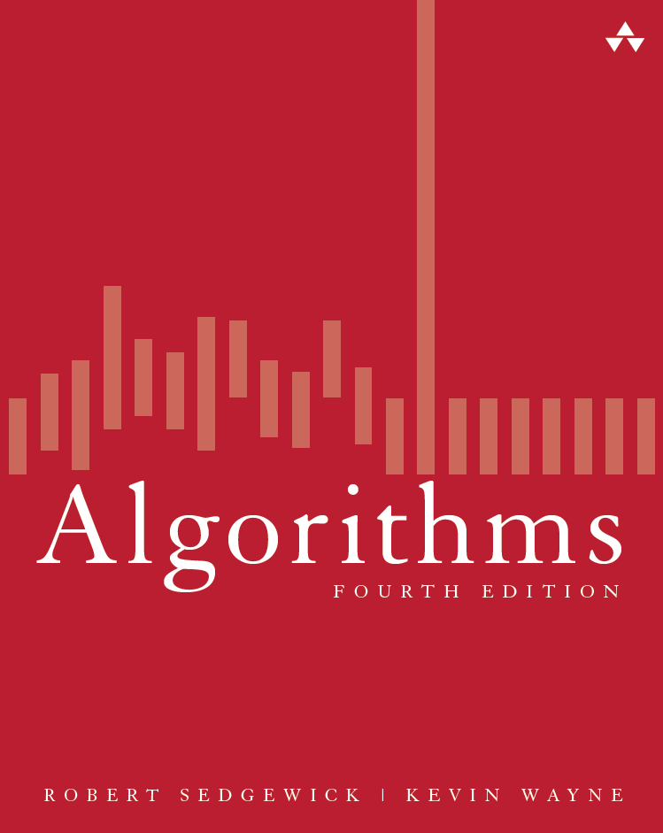

Slide 45
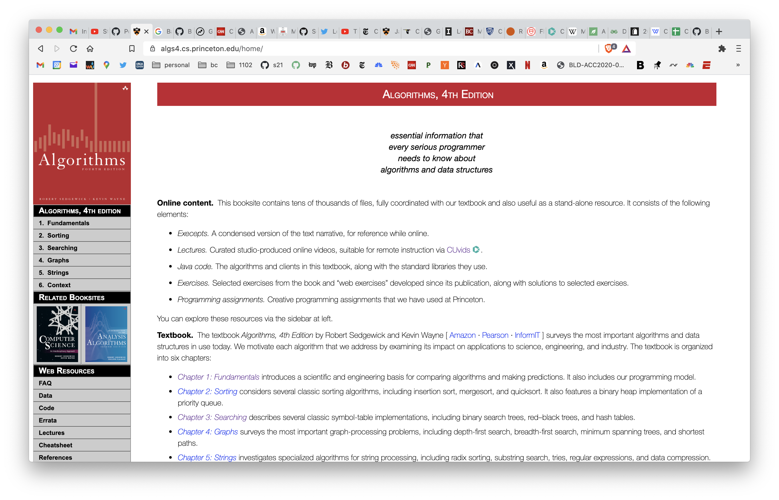

Slide 46
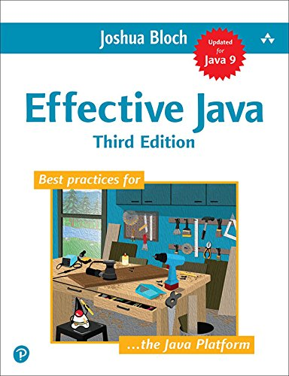

Slide 47
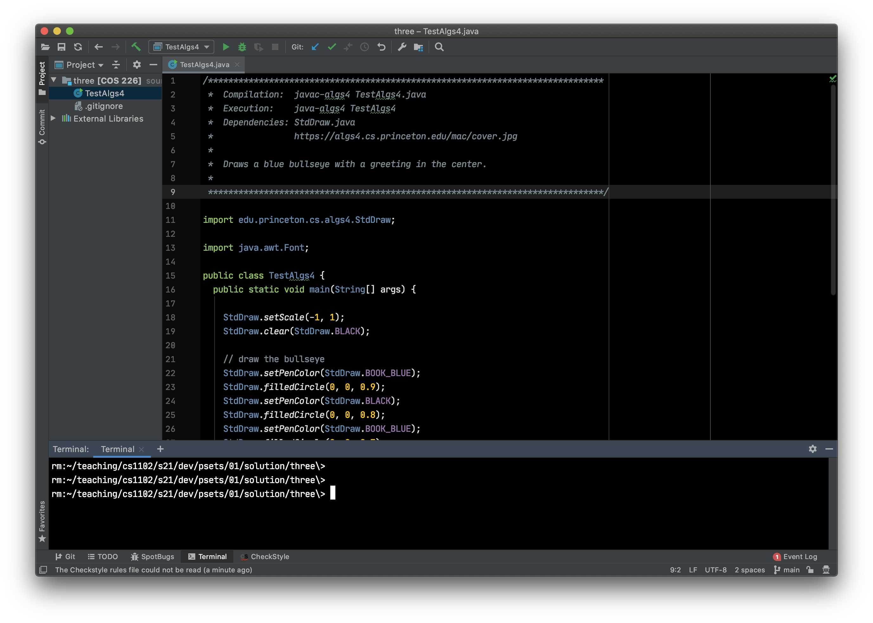

Slide 48
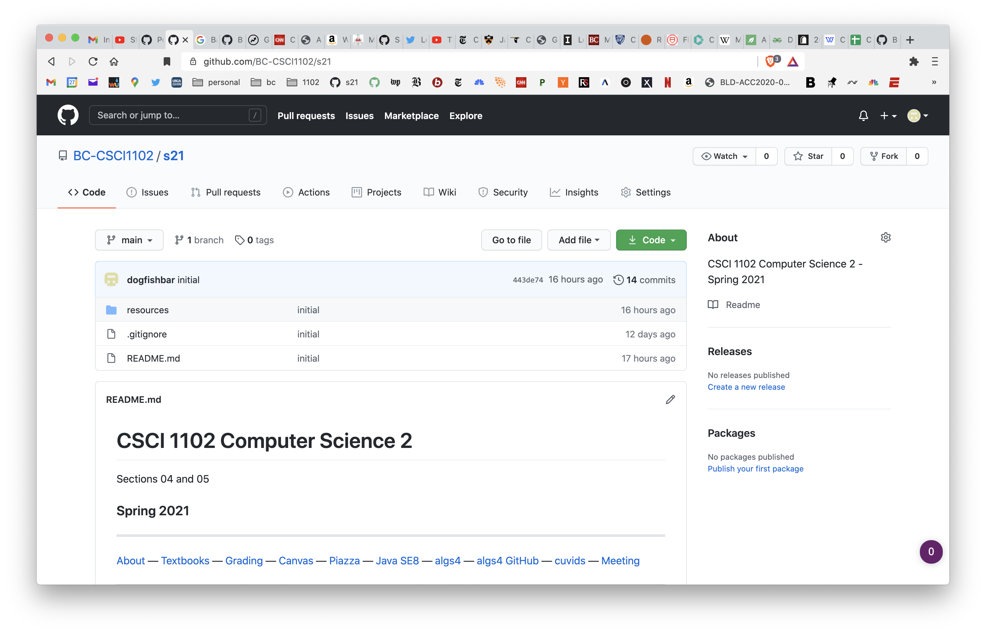

Slide 49
Work
Ten software projects
Three short quizzes
Reading
Participation – class & piazza forum

Slide 50
Grading
Ten software projects – 140 points
Three short quizzes – 30 points
Reading
Participation – 30 points

Slide 51
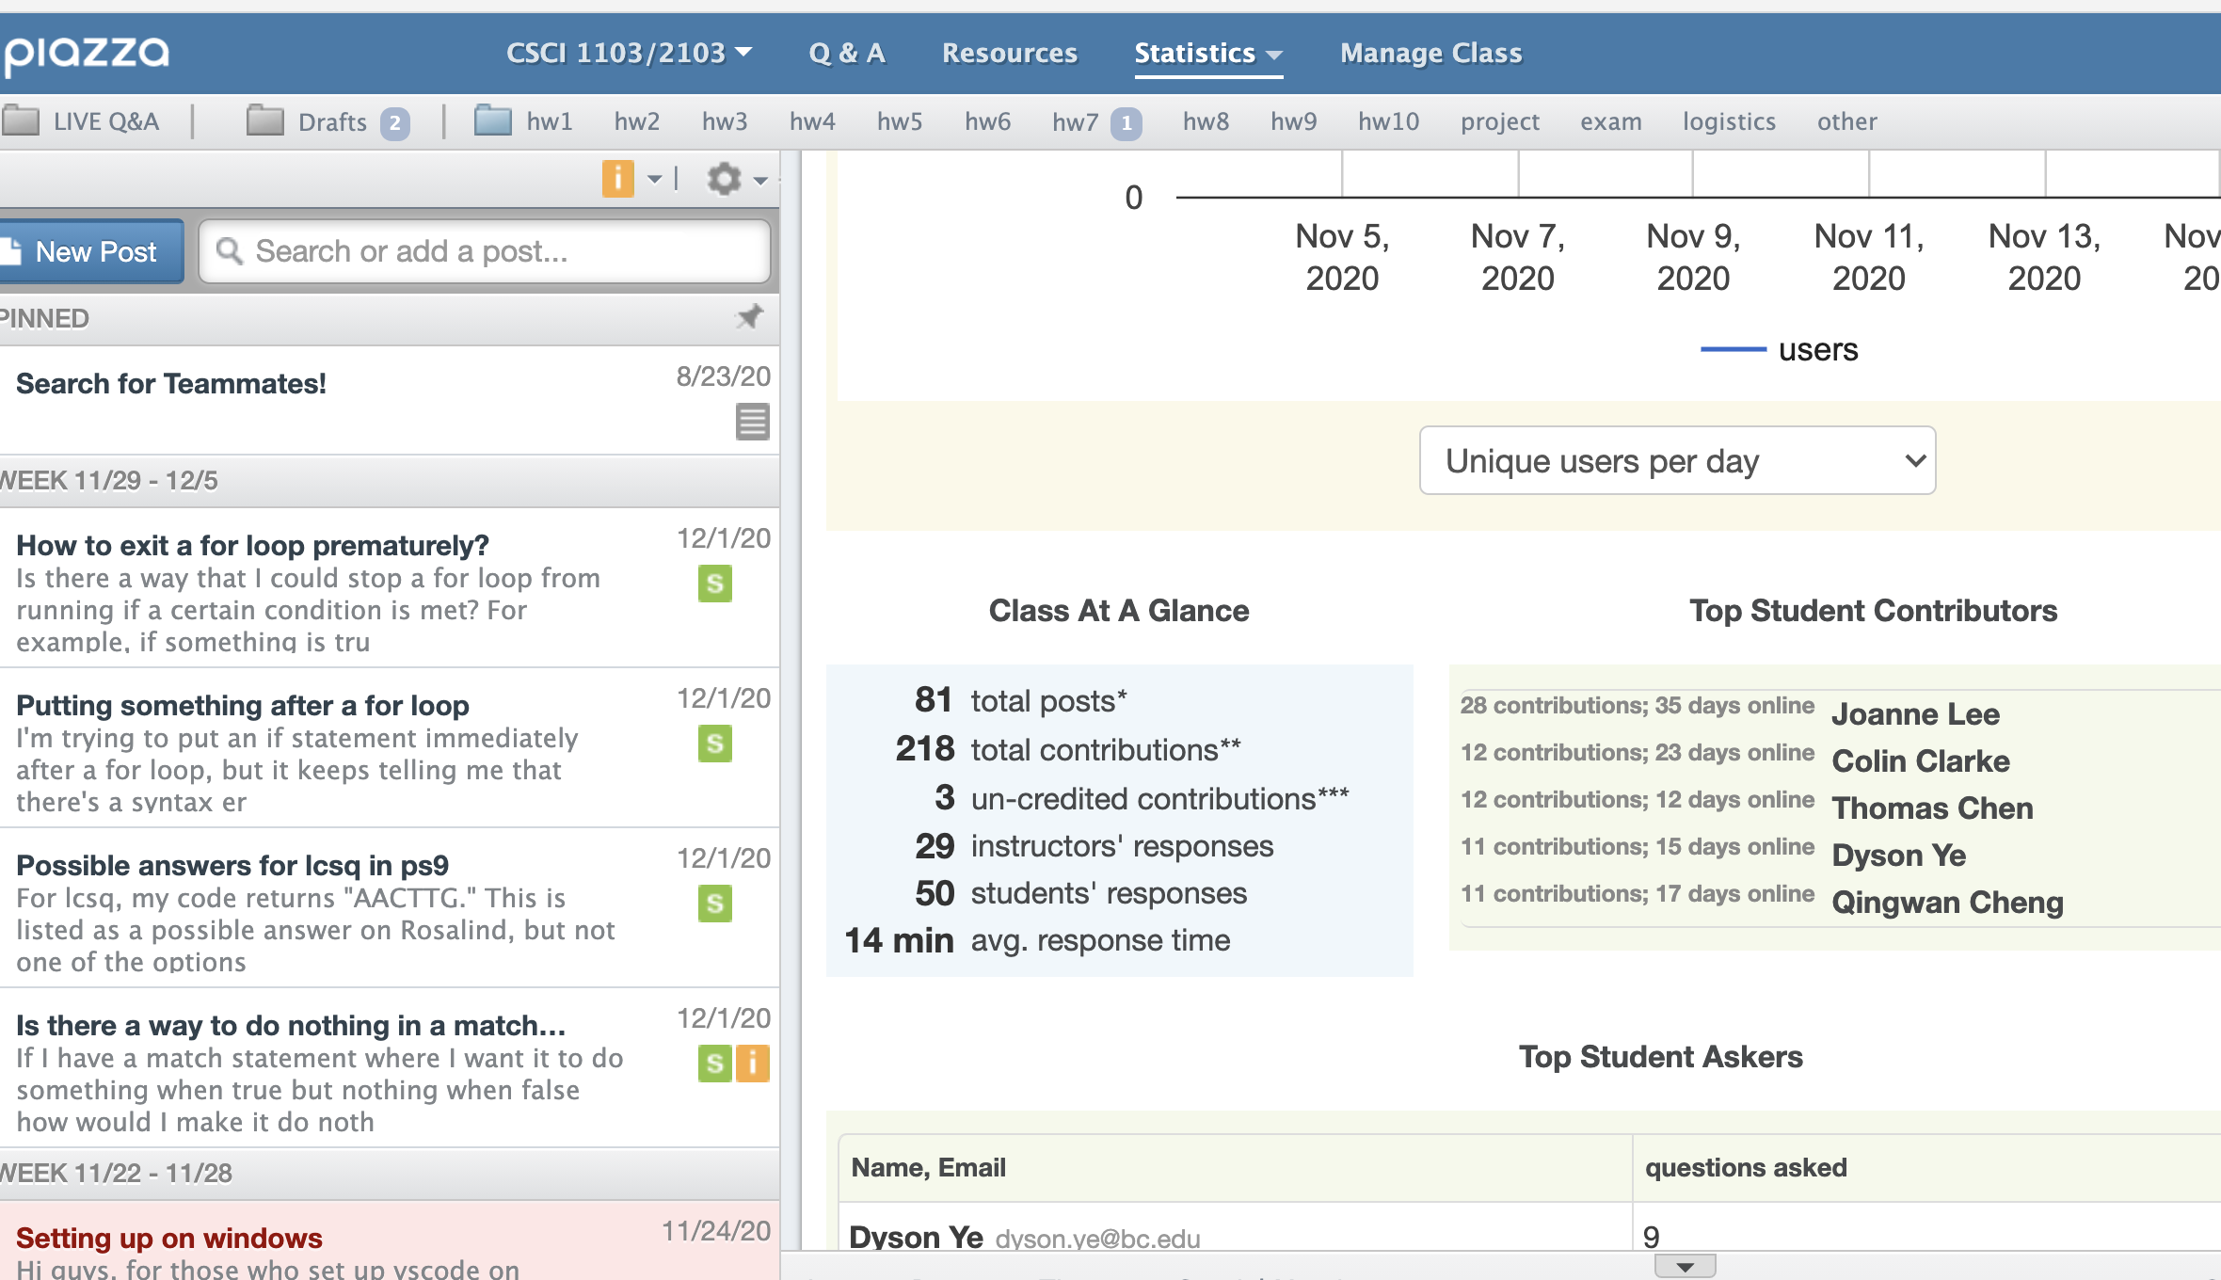

Slide 52
Challenges
This damnable pandemic and all that entails.
Pythonistas: coming to terms with types
OCamlers:
No either/or types or pattern matching;
Imperative style, mutability is the default.

Slide 53
First couple of weeks

Slide 54
How to Succeed
Actually read the Algorithms textbook!
Start problem sets right away.
Persist! --- If you’re not confused and uncomfortable most of the time, you aren’t doing it right.
Work a little harder to stay engaged.

Slide 55


